Slide 1

How to fine tune BERT for text classification?
Jason Zhang, Erin Yang, Wenjie Gu, Shaoling Han
Team Anonymous

Slide 2
Pre-train in language model
Data (large corpus)
Pre-trained task(s)
Translation, classification, etc.
word2vec, glove
Pre-trained model
Target task(s)
GPT, BERT
fine-tuning
Target model

Slide 3
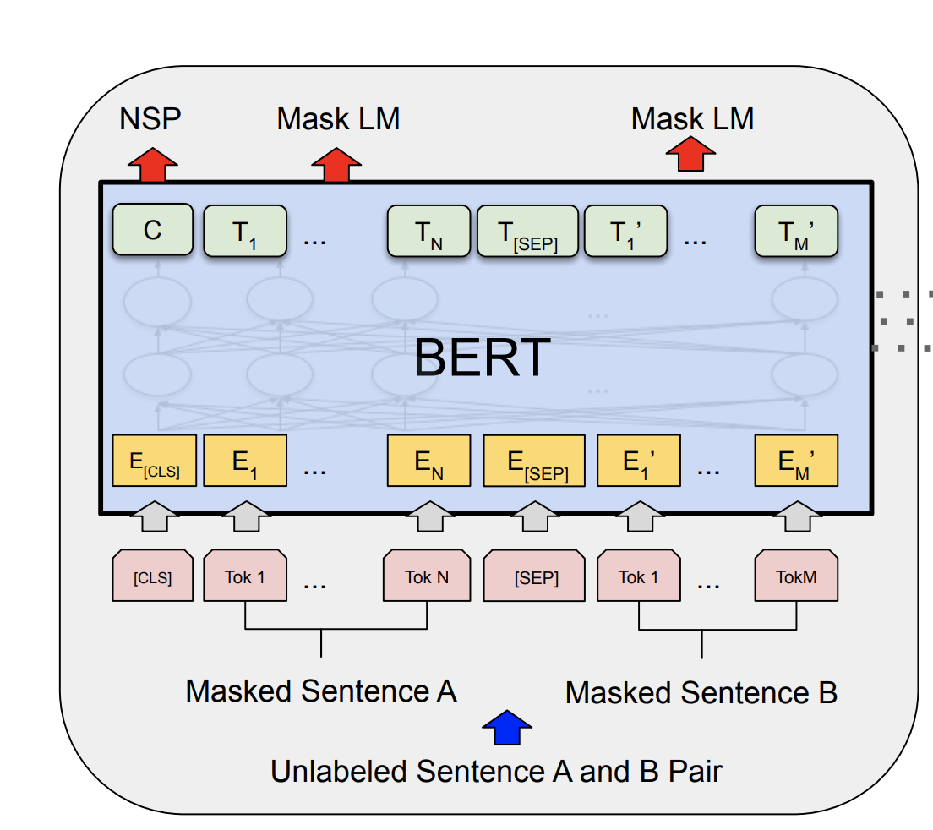
BERT Introduction:
BERT: Bidirectional Encoder Representations from Transformers.
Structure: Pretty similar to the encoder of Transformer

Slide 4
BERT Introduction:
Bert Base:
12 Transformer Blocks
12 self attention heads per layer
110M parameters!

Slide 5
BERT Introduction:
Bert Base:
Pretrained on the BooksCorpus (800M words) and English Wikipedia (2,500M words)
Notes:
Successfully captured syntactic and semantic information from a very broad domain

Slide 6
How do we apply BERT for Text Classification?

Slide 7
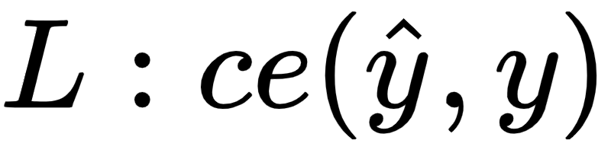
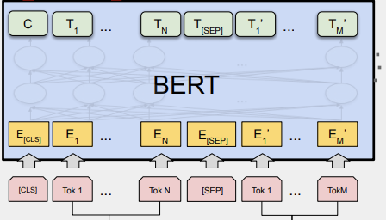
How do we apply BERT for Text Classification?
Softmax
Dense

Slide 8
Fine-tuning methods
Fine-Tuning Strategies
Further Pre-training
Multi-Task Fine-Tuning

Slide 9
Fine-Tuning Strategies
How to deal with long text?
Maximum sequence length of BERT is 512
Which layer to choose for our classification task?
Which layer works for the best for target task?
How to prevent overfitting? How to set appropriate learning rate?

Slide 10

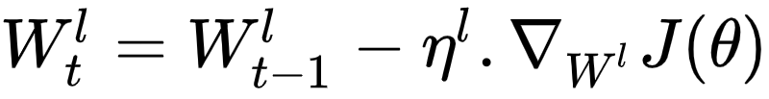
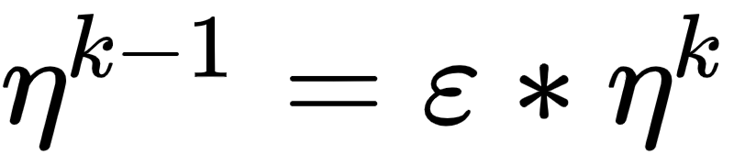
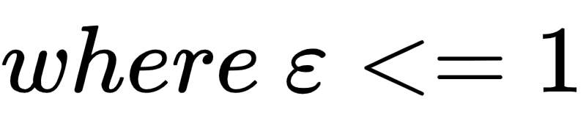
Fine-Tuning Strategies
Adaptive Learning rate:
Represent Weight for each layer

Slide 11
Further Pre-training
Domain specific Task
Further pre-train BERT using MLM and NSP on domain specific data

Slide 12
Further Pre-training
Within-task pre-training
In-domain pretraining
Cross-domain pre-training

Slide 13
Multi-Task Fine-Tuning
Maybe an effective approach to share knowledge from several tasks
Each task has a private classifier layer

Slide 14
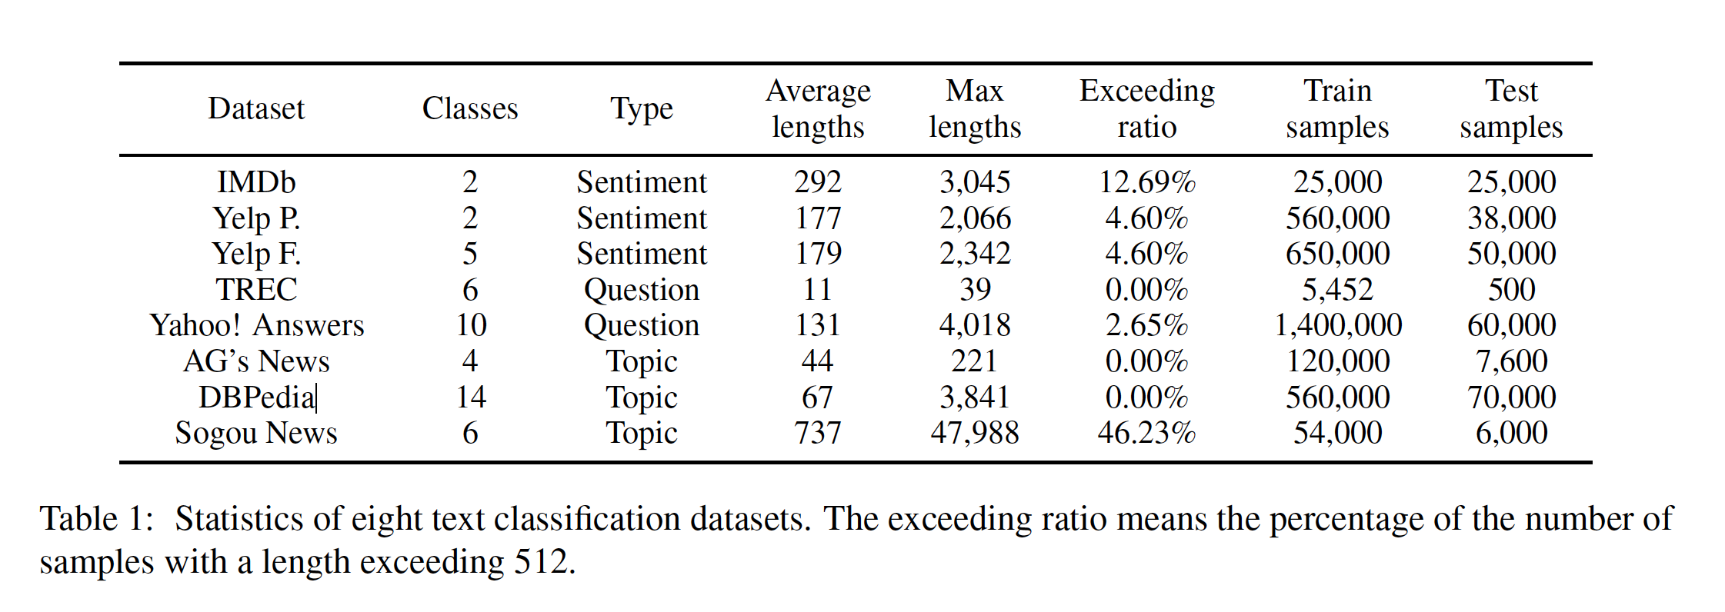
Experiments Datasets
EIGHT Text Classification Datasets divided into THREE task domains
Sentiment analysis: IMDb, Yelp- Binary Classes, Yelp- Five Classes
Question classification: TREC, Yahoo! Ansers
Topic classification: AG’s News, DBPedia, Sogou News

Slide 15
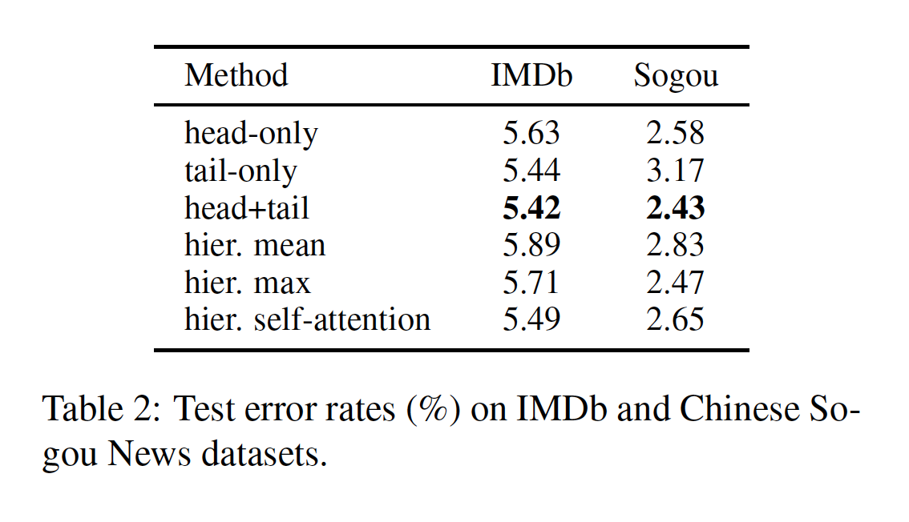
Experience I: Investigating Different Fine-Tuning Strategies
Long texts Processing
Truncation methods
Head-only: keep first 510 tokens
Tail-only: keep last 510 tokens
Head+Tail: take the first 128 and the last 382 tokens
Hierarchical method
Divide into fractions
Feed into BERT separately
Combine the representations for each fraction

Slide 16
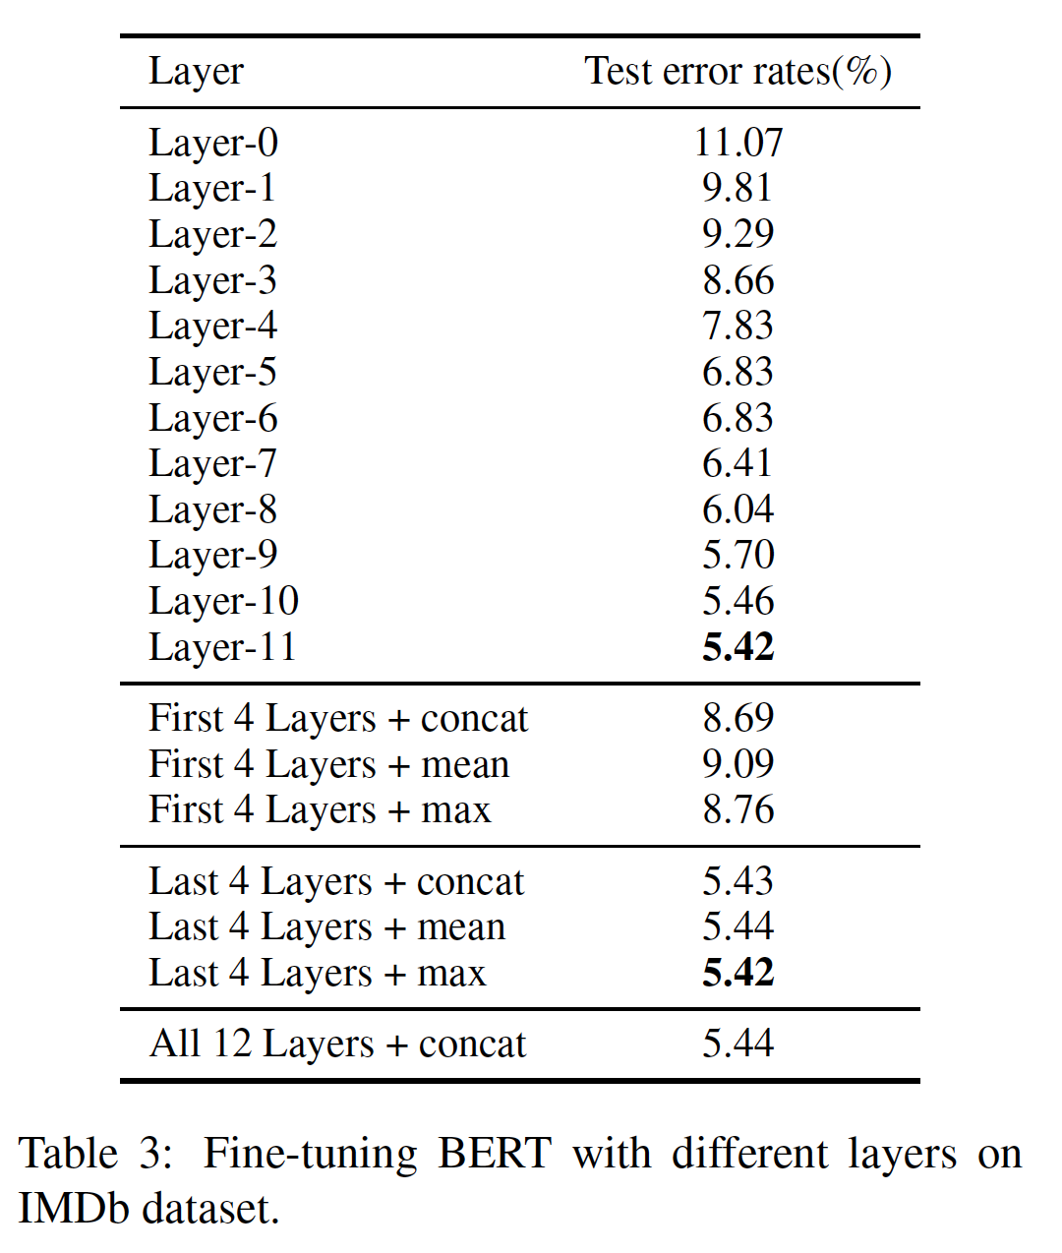
Experience I: Investigating Different Fine-Tuning Strategies
Fine-tune Different Layers
Different layers capture different features of the text
Fine-tuning different layers has distinct effect
Fine-tuning the last layer gives the best performance

Slide 17
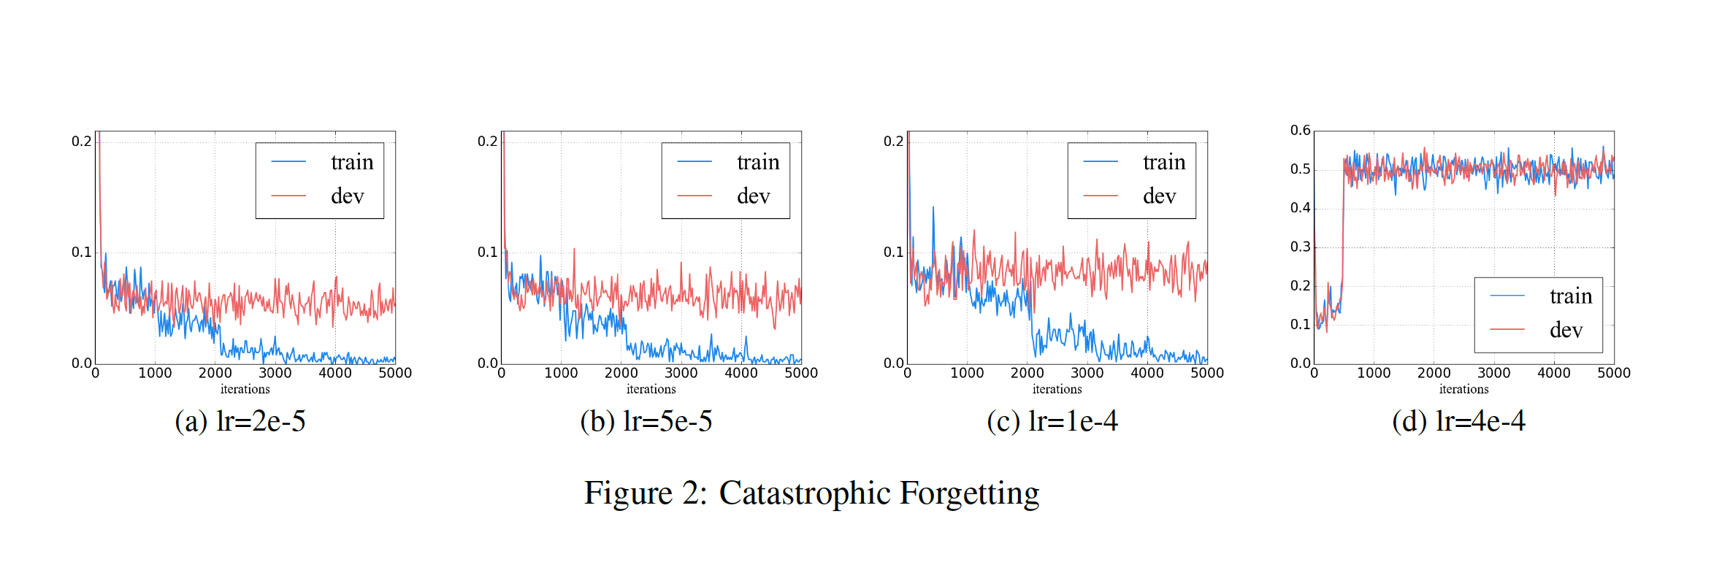
Experience I: Investigating Different Fine-Tuning Strategies
Catastrophic Forgetting: Tendency of an ANN to completely and abruptly forget previously learned information upon learning new information

Slide 18
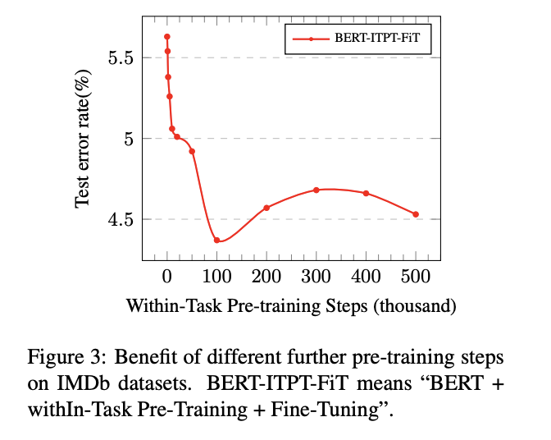
Experiment II: Further Pre Training
Within-Task Further Pre-Training
Sentiment Analysis: IMDb film review
Performance Improvement observed

Slide 19
Experiment II: Further Pre Training
In-Domain and Cross-Domain Further Pre-Training
Sentiment | Question | Topic
IMDb | TREC | AG’s News
Yelp P. | Yahoo! | DBPedia
Yelp F.

Slide 20
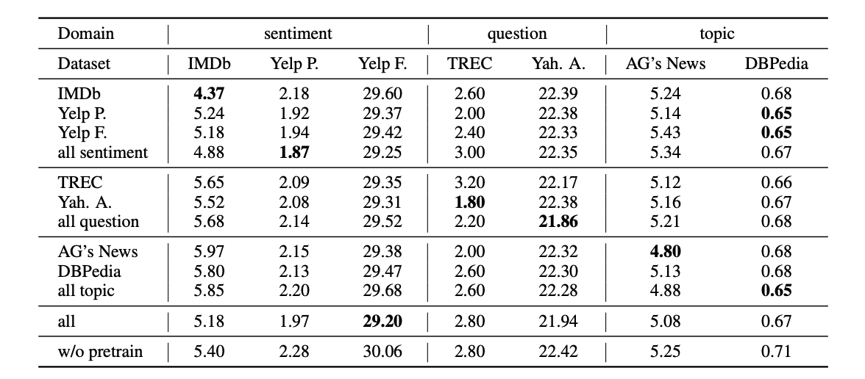
In-Domain and Cross-Domain Further Pre-Training
Target task
Data for pre-training
Error rate table

Slide 21
Obs 1: further pre-training models > original BERT-base model
Obs 2: In-domain pre-training > within-task pre-training
Obs 3: Cross-domain brings no obvious benefit
Target task
Data for pre-training

Slide 22
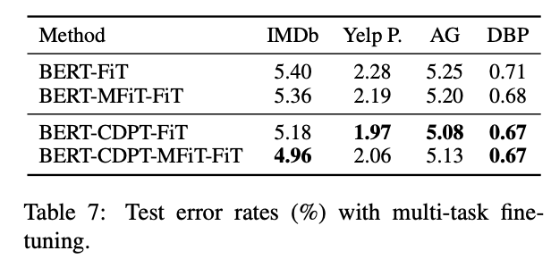
Experiment III: Multi-task Fine-Tuning
No consistent improvement observed

Slide 23
Thoughts on the paper
Introduce useful ideas for fine tunings
Limitation: generalizability
within-task pre-training experiment only test on one dataset
Data, task specific
Lack of clear explanation of why it works/not works

Slide 24
Q&A
Is there a consensus in the NLP community that the CLS token is the best way to derive meaning (classifications) from the 512 tokens that are the input to the BERT model? Why suffice to only use the vector associated with [CLS] to make classifications? Isn't it just a start-of-sentence token that's not part of the sentence?
Notes:
As I mentioned earlier, the BERT encoder produces a sequence of hidden states. For classification tasks, this sequence ultimately needs to be reduced to a single vector. There are multiple ways of converting this sequence to a single vector representation of a sentence. One is max/mean pooling. Another is applying attention. The authors, however, opt to go with a much simpler method: simply taking the hidden state corresponding to the first token.
To make this pooling scheme work, BERT prepends a [CLS] token (short for "classification") to the start of each sentence (this is essentially like a start-of-sentence token).

